Slide 1
Reproductive Justice
Presenters: Yara Alhusari, Tateanne Green, Aliyah Warr, Sabrina Vahobova, Lindsay Hernandez

Slide 2
WHAT IS ABORTION?
Abortion is a method of terminating a pregnancy. The embryo or fetus, as well as the placenta, are removed from the uterus using medicine or surgery. A licensed health care expert performs the operation. The choice to abort a pregnancy is a deeply personal one.
Notes:
YARA ALHUSARI

Slide 3
The History of Abortions
Biblical Era: If a woman deviates from her husband, she must be brought to the priest, who will give her "bitter water that brings a curse," according to Numbers 5:11-31. Essentially, she is doomed to miscarry.
Ancient Egypt: used crocodile dung in a dough that was placed into the vaginal canal as a spermicide and to induce a miscarriage, according to the Kahun Papyrus.
Ancient Greeks: Pennyroyal was utilized for a variety of purposes, including as a culinary herb, low-dose birth control, pest control, and more. It was so well-known that Aristophanes included a reference to it in his comedy "Lysistrata." Pennyroyal was also described in a document attributed to Cleopatra as an effective abortifacient. It has been grown in typical family gardens for ages, including those of early American settlers.
Ancient China: Mercury was used in ancient China to force a miscarriage. Their ancient handwritten texts also contain 48 volumes of abortion prescriptions.
America: Cottonwood was used by African women brought to the United States as slaves to abort as a result of rape, usually from slave owners. To terminate pregnancies, they employed "juniper bush savin, pennyroyal, tansy, ergot, and Seneca snakeroot."
Notes:
YARA ALHUSARI

Slide 4
HISTROICAL METHODS OF ABORTION
The use of syringes to "destroy the living characteristics" of sperm was advertised.
The abortion pill was introduced to the market, but it could only be used by married women who had received a doctor's prescription.
1866
1965
1830s
1900s
People caused miscarriages by using "knitting needles, crochet hooks, hairpins, scissors, and button hooks to induce miscarriage and terminate pregnancies, often suffering significant injuries to themselves or death"
For more than 35 years, Madame Restell was the most well-known abortionist. Magazines and traveling saleswomen were used to promote her pills and powders. Women were sent to her clinic for a surgical procedure if those methods failed.
Notes:
YARA ALHUSARI

Slide 5
TIMELINE OF ABORTION LAWS IN THE UNITED STATES
1873
02
Except in circumstances deemed absolutely essential by a qualified doctor, the Comstock Law made contraception and abortion illegal.
1972
In Eisenstadt v. Baird, the Supreme Court ruled that married couples have a right to contraception information.
Until the Roe v. Wade case, when it was decided that women had the right to privacy, including the ability to terminate their pregnancy, both elected and voluntary abortions were unlawful.
1973
1896
Midwives in Chicago were prohibited from owning any tool used in abortion procedures by the Chicago Health Department.
President Bush signed a nationwide ban on all abortion procedures into law after it was passed by Congress, but it was quickly overturned in court by the National Abortion Federation.
1965
In Griswold v. Connecticut, a court case involving contraception, a woman's privacy was upheld.
2003
Notes:
YARA ALHUSARI

Slide 6
Current politics on abortion
Opponents and proponents of abortion rights are still fighting in court, at the ballot box, and in state legislatures nearly five decades after the United States Supreme Court's Roe v. Wade ruling. In order to give the Supreme Court a chance to overturn its Roe ruling, some states have introduced or passed new abortion restrictions in 2021, and the high court decided in May to review a Mississippi law that intends to make most abortions after 15 weeks of pregnancy illegal. Since Justice Amy Coney Barrett took the bench in October, this will be the court's first abortion law review.
Notes:
YARA ALHUSARI

Slide 7
Statistics on Abortion
The CDC has been collecting information on legal abortions since 1969 (CDC) But this doesn’t mean that abortions didn’t exist prior to this time.
Over 629,898 legal abortions were reported to the CDC in 2019 (CDC)
It is important to note here that not all legal abortions are reported to the CDC by abortion providers so this number could be higher.
Women in their twenties accounted for the majoirtity of abortions which is 56.9% of abortions. (CDC)
Non-Hispanic White Women and Non-Hispanic Black Women accounted for the largest percentage of all abortions. 33.4% for Non-Hispanic White Women and 38.4% of Non-Hispanic Black Women. (CDC)
Non-Hispanic Black women had the highest abortion rate (23.8 abortions per 1,000 women) and ratio (386 abortions per 1,000 live births). (CDC)
From the 42 areas that reported marital status for 2019, 14.5% of women who obtained an abortion were married, and 85.5% were unmarried. (CDC)
At 2014 abortion rates it can be concluded that one in four women will have an abortion by age 45. (Induced abortion in the US, Guttmacher Institute)
Notes:
TATEANNE

Slide 8
Difficulties that women face when trying to have abortions
In 2014, 65% of abortion patients traveled less than 25 miles one way to obtain care, 17% traveled 25–49 miles, 10% traveled 50–100 miles and 8% traveled more than 100 miles. (Induced abortion in the US, Guttmacher Institute)
Greater distances to abortion facilities are associated with increased burden on patients, including higher out-of-pocket costs for associated services such as food, lodging and child care; lost wages; increased difficulty getting to the clinic; delayed care;17 and decreased use of abortion services. (Induced abortion in the US, Guttmacher Institute)
Abortion patients who lived in states with waiting period requirements and adolescents who lived in parental notification states traveled farther than those in states without such laws. (Induced abortion in the US, Guttmacher Institute)
Notes:
TATEANNE

Slide 9
Difficulties with women face when trying to have abortions (Cont).
However, since 2010, the U.S. abortion landscape has grown increasingly restrictive as more states adopt laws hostile to abortion rights. Between January 1, 2011 and July 1, 2019, states enacted 483 new abortion restrictions, and these account for nearly 40% of all abortion restrictions enacted by states in the decades since Roe v. Wade. Some of the most common state-level abortion restrictions are parental notification or consent requirements for minors, limitations on public funding, mandated counseling designed to dissuade individuals from obtaining an abortion, mandated waiting periods before an abortion, and unnecessary and overly burdensome regulations on abortion facilities. (State Facts about Abortion, Guttmacher Institute)
States have enacted 106 abortion restrictions so far in 2021, a year that has been marked by unprecedented threats to U.S. abortion rights and access. (Nash, Guttmacher Institute)
Notes:
TATEANNE

Slide 10
Income and Health Coverage
In 2014, three fourths of abortion patients were low income. 49% living at less than the poverty level (which is calculated at $15,730 a year for a family of 2) and 26% living at 100-199% of the poverty level. (Jerman, Guttmacher Institute)
The Hyde Amendment currently bans the use of federal dollars for abortion coverage for people enrolled in Medicaid, the nation’s main public health insurance program for low-income individuals. Similar restrictions apply to other federal programs and operate to deny abortion care or coverage to people with disabilities, Native Americans, prison inmates, poor and low-income individuals in the District of Columbia, military personnel and federal employees. (Induced abortion in the US, Guttmacher Institute)
Although the Hyde Amendment bars federal funds from being used to provide Medicaid coverage of abortion, states may use their own, nonfederal funds. Fifteen states have a policy requiring the state to provide abortion coverage under Medicaid. (Induced abortion in the US, Guttmacher Institute)
In 2014, Medicaid was the second-most-common method of payment and was reported by 24% of abortion patients. The overwhelming majority of these patients lived in the 15 states that allowed state funds to be used to pay for abortion. (Induced abortion in the US, Guttmacher Institute)
Fifteen percent of patients used private insurance to pay for the procedure. Most patients with private insurance (61%) paid out of pocket. (Induced abortion in the US, Guttmacher Institute)
Notes:
TATEANNE

Slide 11
Abortion Laws and Restrictions Impact on WOC
Among the poorest women, Hispanics are the most likely to experience an unintended pregnancy. Overall, however, black women are three times as likely as white women to experience an unintended pregnancy; Hispanic women are twice as likely. Because black women experience so many more unintended pregnancies than any other group—sharply disproportionate to their numbers in the general population—they are more likely to seek out and obtain abortion services than any other group. (Cohen, Guttmacher Institute)
One of the effects of systemic racism in this country is that most women of color are disproportionately likely to have low incomes and to be insured through Medicaid. Among women aged 15–49, 29% of Black women and 25% of Hispanic women were enrolled in Medicaid in 2019, compared with 15% of White women and 12% of Asian women. (The Hyde Amendment: A Discriminatory Ban on Insurance Coverage of Abrotion, Guttmacher Institute)
Notes:
TATEANNE

Slide 12
Abortion Laws and Restrictions Impact WOC (Cont).
“Following the Supreme Court’s decision in June Medical Services v. Russo this week, it is worth reflecting on the racist origins of the anti-abortion movement in the United States, which date back to the ideologies of slavery. Just like slavery, anti-abortion efforts are rooted in white supremacy, the exploitation of Black women, and placing women’s bodies in service to men. Just like slavery, maximizing wealth and consolidating power motivated the anti-abortion enterprise. Then, just as now, anti-abortion efforts have nothing to do with saving women’s lives or protecting the interests of children. Today, a person is 14 times more likely to die by carrying a pregnancy to term than by having an abortion, and medical evidence has shown for decades that an abortion is as safe as a penicillin shot—and yet abortion remains heavily restricted in states across the country” (Goodwin).
“Today, as people debate whether anti-abortion platforms benefit Black women, the clear answer is no. The U.S. leads the developed world in maternal and infant mortality. The U.S. ranks around 50th in the world for maternal safety. Nationally, for Black women, the maternal death rate is nearly four times that of white women, and 10 to 17 times worse in some states” (Goodwin).
Notes:
TATEANNE

Slide 13
Values in Humanity, Politics + Law
Abortions
Fundamental Right > Constitutional Right
Supreme Court Legalized Abortions
Roe VS Wade, 1971-1973
Jane Roe (a fictional name) plaintiff, pregnant single women
Henry Wade, the district attorney of Dallas County, Texas
Texas Abortion Law: illegal except by a doctor’s orders to save a woman’s life
1 Amendment: Rights to Religion, Speech, Press, Assembly, Petition
4 Amendment: Protects citizens from unreasonable search and seizure
5 Amendment: Citizens not be subject to criminal prosecution and punishment without due process
9 Amendment: The people retain all rights not enumerated.
14 Amendment: Rights Guaranteed, Privileges and Immunities of Citizenship, Due Process and Equal Protection
Notes:
Lindsay
Roe VS Wade: Argued 1971 , Reargued 1972 & Decided January 22nd 1973
Roe alleged that she was unmarried and pregnant; that she wished to terminate her pregnancy by an abortion "performed by a competent, licensed physician, under safe, clinical conditions"; that she was unable to get a "legal" abortion in Texas because her life did not appear to be threatened by the continuation of her pregnancy; and that she could not afford to travel to another jurisdiction in order to secure a legal abortion under safe conditions. She claimed that the Texas statutes were unconstitutionally vague and that they abridged her right of personal privacy, protected by the First, Fourth, Fifth, Ninth, and Fourteenth Amendments. By an amendment to her complaint, Roe purported to sue "on behalf of herself and all other women" similarly situated.
Texas had the strictest anti-abortion law in the country that, even if you were a documented of rape or incest you were still not allowed to have an abortion. Abortions were ony allowed it it was life threatening.
Amendment #9
In recent years, some have interpreted it as affirming the existence of such “unenumerated” rights outside those expressly protected by the Bill of Rights.

Slide 14
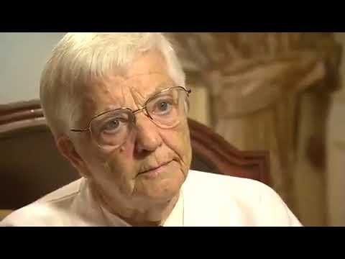
Modern Day Politics + Narratives
https://www.youtube.com/watch?v=XxYW-B-64Fo&feature=youtu.be
Polarized Nation
45th President
White Supremacy
Selective Pro-Life Stances
Same Sex Parents Adopting
Children in Cages
“Free Healthcare for promiscuity”
Casey Anthony
Picking the lesser of two evils
Notes:
Lindsay
Same Sex Parenting: No parents for kids & livlihood development
Children in Cages: Kids with jail like livelihood
Free Healthcare for promiscuity: No sexual promiscuity
Casey Anthony: mothers who kill neglect their children within circumstances of their disappearances/death
Same Sex Parents Adopting
For example, in 2005, the American Psychological Association (APA) issued an official brief on lesbian and gay parenting, which included this assertion: “Not a single study has found children of lesbian and gay parents to be disadvantaged in any significant respect relative to children of heterosexual parents” (American Psychological Association 2005).
Growing up with gay parents: What is the big deal?*, https://www.ncbi.nlm.nih.gov/pmc/articles/PMC4771005/
Children in Cages
the acting Deputy Washington Director and Senior Researcher on Immigration in the US Program at Human Rights Watch.
On June 17 and 19 (of 2019) I interviewed children detained at the Clint Border Patrol Station, and on June 18, I interviewed children and their families at the El Paso Station (also known as Station 1) and the Santa Teresa Border Patrol Station. I personally interviewed 16 detained children in these three facilities, while our monitoring team interviewed over 50 children throughout our visit.
jail-like border facilities for weeks at a time without contact with family members, or regular access to showers, clean clothes, toothbrushes, or proper beds. Many were sick. Many, including children as young as 2 or 3, were separated from adult caretakers without any provisions for their care besides that provided by unrelated older children also being held in detention. These conditions are consistent with those Human Rights Watch documented in our February 2018 report, “In the Freezer.”[5] In contrast with the conditions as of February 2018, the harms of CBP detention for children are now compounding over weeks instead of days.
Written Testimony: "Kids in Cages: Inhumane Treatment at the Border" https://www.hrw.org/news/2019/07/11/written-testimony-kids-cages-inhumane-treatment-border#
Casey Anthony.
a young Florida mother … was found her not guilty of first degree murder, not guilty of aggravated manslaughter and not guilty of aggravated child abuse.
She was found guilty on four counts of providing false information to a law enforcement officer.Prosecutors said that the now-25-year-old Anthony wanted to be free of the responsibilities that come with being a mother. They built a case that included evidence of a body (her 2 year old daughter Caylee Marie Anthony) having been kept in the trunk of Anthony's car for a substantial period of time. And they alleged that Anthony had lied repeatedly about where Caylee was during the month between when the girl disappeared and when authorities were notified. Caylee's remains were eventually found "scattered in woods ... just blocks from the home she shared with her family," the Orlando Sentinel writes
Casey Anthony Found Not Guilty Of Killing Her Daughter, https://www.npr.org/sections/thetwo-way/2011/07/06/137627015/casey-anthony-found-not-guilty-of-killing-her-daughter
Prosecutors argued all along that Ms. Anthony killed her child so she could carouse with her boyfriend, go clubbing and live the “bella vita” — beautiful life — as her tattoo, done after Caylee’s disappearance, proclaimed. They used jailhouse recordings of Ms. Anthony and photographs of her revealing with friends to show she was clearly not grieving.
Casey Anthony Not Guilty in Slaying of Daughter, https://www.nytimes.com/2011/07/06/us/06casey.html

Slide 15
Social Media | Hashtag Activism
#ShoutYourAbortion:
Creator: Amelia Bonow and Lindy West
Goal: encourage women who kept their abortion a secret to speak up considering congress is investigating Planned Parenthood and planning on cutting off it’s funding (due to undercover videos).
“Ms. Sinreich, who now has a 6-year-old son, first posted on Twitter in September: “In 1988 a late-term abortion got a teenage me back on track for college, career, & motherhood.” - NY TIMES.
“Having an abortion made me happy in a totally unqualified way. Why wouldn’t I be happy that I was not forced to become a mother?” - NY TIMES
Notes:
Aliyah

Slide 16
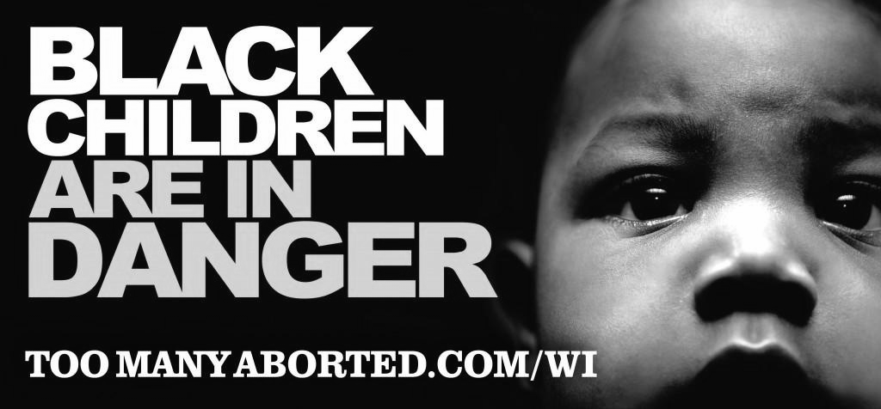
Ads & Campaigns
Pro-Life Billboard: “The most dangerous place for an African American is in the womb”.
Origin: Dallas Based Anti-Abortion Organization
Goal: Emphasize that Black women have abortions at higher rates than women of other ethnic groups in New York City.
Pro-Life Billboard: “Black Children are in Danger”.
Origin: Pro-life Wisconsin
Goal: Spread Planned Parenthood’s history of racism.
Pro-Life Campaign: See Life™: "Will I?" | #LoveEveryHeartbeat”.
Origin: Background on Focus on the Family: Christian organization founded in 1977 and it promotes social conservative views on public policy. Their mission is to glorify God through the relationship with Jesus Christ.
Goal: Harnesses on the potential experiences an unborn child can live through if not aborted.
Notes:
Aliyah

Slide 17
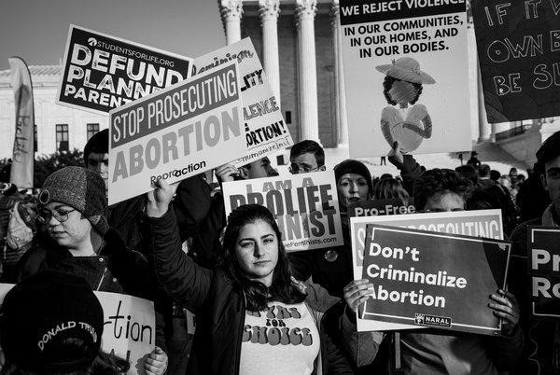
Overall Ideas & Stigmas
Fixation on shaming women.
Dividing women.
Control over women’s reproductive rights.
Guilt trip
Notes:
Aliyah

Slide 18
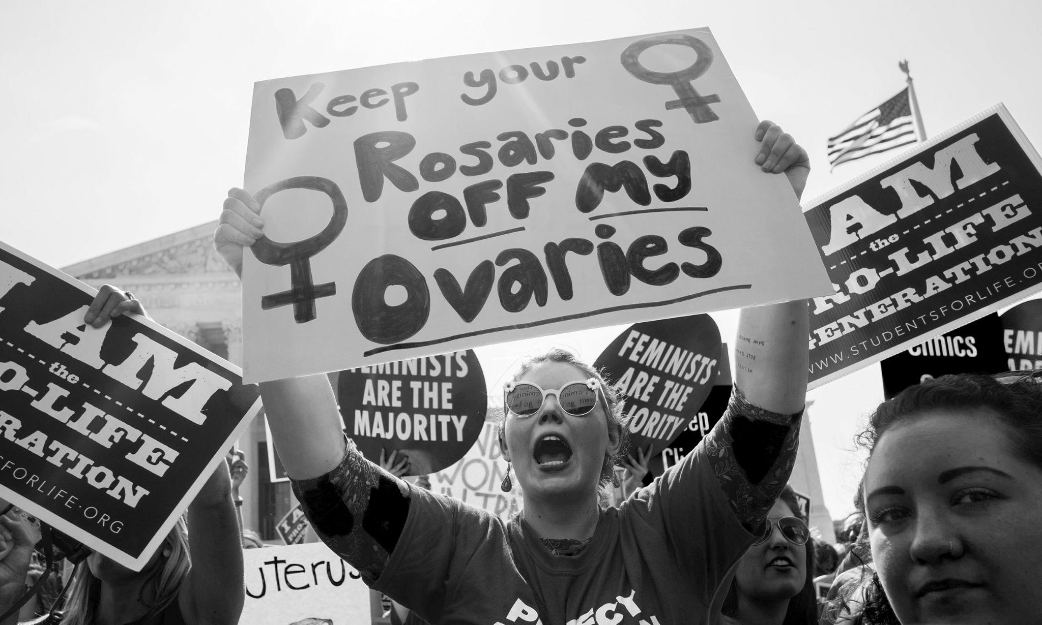
Documentaries
Anti-abortion Crusaders: Inside the African-American Abortion Battle
Director: Yoruba Richen
Year: 2017.
Goal: Dive into Black anti-abortion movements, groups and activists that are actively working inside the Black community to manipulate.
Religion
Planned Parenthood - The Negroe Project
Racism
Reversing Roe
Director: Annie Sundberg, Ricki Stern.
Year: 2018.
Goal: Shed light through interviews with abortion rights supporters, gynocolgists that lived through illegal abortions and feminists. It runs through the history of abortions and restrictions being put in place.
State Ultrasound Requirement
Operation Rescue
Doctors threat to safety
The 700 Club & Religion
Notes:
Aliyah

Slide 19
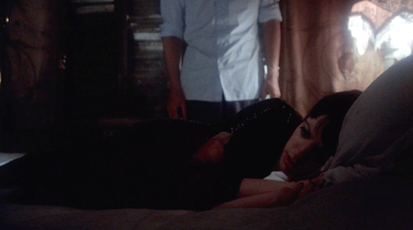
Films & Shows
Cabaret
Director: Bob Fosse
Year: 1972
Goal: Showcases an accurate portrayal of the results of an abortion through an aspiring actress Sally’s experience.
Sex Education / Season 1 / Episode 3
Creator: Laurie Nunn
Year: 2019
Goal: Showcases an accurate portrayal of abortion through high schooler Maeve’s experience.
Notes:
Aliyah

Slide 20
Organizations that Provide & Advocate for Abortions
Planned Parenthood Federation of America
→ a nonprofit organization that provides sexual health care in the U.S and globally
→ Founded in 1916 at the first abortion clinic in Brownsville Brooklyn
→ Operates more than 600 affordable health care centers for women, men and young people in the U.S.
→ Nation’s largest provider of sexual education
→ Gives many more services such as;
Abortions
Abortion referrals
Birth control/Emergency contraception
Covid-19 vaccines
HIV services
LGBTQ services
Mental Health
And more...
Notes:
SABRINA

Slide 21
Organizations that Provide & Advocate for Abortions
National Abortion Federation
→ The NAF is a professional association of abortion providers
→ Was established in 1977
→ In a partnership with Planned Parenthood and together they developed a project called Clinical Abortion Staffing Solutions(CASS)
→ Also created the Clinicians in Abortion Care(CIAC) a group sponsoring by NAF who represent certified nurse-midwives, nurse practitioners, physician assistants, registered nurses, and students of those professions.
→ Gives easy access information on what to expect if a person wants an abortion on their website(https://bit.ly/3y7dr6U)
Notes:
SABRINA

Slide 22
Organizations that Provide & Advocate for Abortions… continued
NARAL Pro-choice America
→ Non-profit organization founded in 1969
→ Advocates for abortion access, birth control, fighting pregnancy discrimination and paid parent leave.
→ Organizes in neighborhoods, communities, cities, and states, bringing millions of people together to take action to defend reproductive freedom.
→ Works to elect candidates committed to reproductive rights and abortion access to safeguard reproductive freedom.
Information found on NARAL website for learning more:
→Abortion Access
→Legislative Restrictions on Access to Abortions
→TRAP Laws
→Medication Abortion
→Abortion Refusal Laws
→Biased Counseling and Mandatory Delays
→Forced Ultrasound Laws
→Young Women’s Access to Abortion
→Anti-Abortion Violence
→Fake Health Centers
Notes:
SABRINA

Slide 23
Lack of Sex Education in the United States:
Currently, there are three kinds of sex ed curricula. One, we already know of is Abstinence-Only, the second is Abstinence-Plus and the third is Comprehensive Sex Education.
Here are their definitions-
Abstinence-Only: curricula that teaches any sexual activity is to be avoided till marriage, another name is Sexual Risk Avoidance.
→ Fails to mention contraception and condoms to prevent the risk of unintended pregnancy and STIs
Abstinence-Plus: is also called Sexual Risk Avoidance, however compared to Abstinence-Only, this curricula teaches about contraception, condoms, etc. while teaching students to avoid sexual activities till marriage.
Comprehensive Sex Education: provides medically accurate, age-approprate information about abstinence and teaches safer sex practice which include contraception and condoms.
→ In addition, this curriculum teaches students that sex is normal and healthy while simultaneously giving information about relationships, communication skills and human development.
Notes:
SABRINA

Slide 24
Lack of Sex Education in the United States(Cont.):
30 states and the District of Columbia require public schools to mandate sexual education.
Only 22 of those states require that sexual education to be medically accurate, which also varies the quality of sex ed as the definition for “medically accurate” is different in these states.
Since the 1990s the United States has put in over a billion dollars in state and federal funding for abstinence-only education which has proven to be ineffective. A 2004 report revealed that 11 out of 13 curricula was found to be inaccurate, which contained subjective, unproven claims regarding the beginning of life, reproductive health and gender traits.
During the Clinton and Bush administrations the government had given much funding to the Abstinence-Only programs. It was during the Obama administration that President Barack Obama moved away from Abstinence-Only towards Comprehensive curricula which ended up being overturned during the Trump Administration and another 75 million dollars went to Abstinence-Only programs once more.
Notes:
SABRINA

Slide 25
Lack of Sex Education in the United States(Cont.):
Why is it important to have Comprehensive Curricula taught in school?
It promotes healthy relations with sex
Provides students with safer means of having sex, with contraception, condoms, etc. which prevents them from getting pregnant or spreading STIs
An important note: studies have shown that teen pregnancies that lead to conceiving the child end up with them not completing their education and living in poverty.
By actively educating students on safer methods many of these problems can be avoided. It is a basic human right for people to learn about their own bodies instead of expecting there to be good results that come out of teaching them to just avoid sex and sexual activities at all costs.
Notes:
SABRINA

Slide 26
Resources
Ways to get involved -
Planned Parenthood:
Volunteering
→ Provide emotional support to patients
→ Discuss the options that are available
→ Offer accompaniment to the hospital with law enforcement
***If you don’t feel comfortable volunteering in physical places you can always join the Planned Parenthood Virtual Volunteer Team!
What they do is,
→ Educate people on their sexual and reproductive rights through storytelling, social media, webinars and more
→ Also post on social media for people to get accurate information about Covid-19 vaccines.
Website: https://www.plannedparenthood.org/get-involved/jobs-and-volunteering
NARAL Pro-choice America:
Volunteering
→ Work in local and state electoral campaigns
→ Make calls to supporters
→ Mail out invitations and information
→ Write letters and circulate petitions in support of pro-choice legislation
→ Complete data-entry and all other administrative tasks necessary to support our important work.
Website: https://secure.everyaction.com/zonRrqxLFUu1im3LO8iTFA2
Notes:
SABRINA

Slide 27
Resources
Sites in case you or someone you know needs sexual health care:
https://www.plannedparenthood.org/health-center
Planned Parenthood:
https://bit.ly/3EG8KDu
https://prochoice.org/patients/naf-hotline/
National Abortion Fedration:
https://prochoice.org/donate/
NAF Hotline: 1-800-772-9100
NAF Referral Line: 1-877-2570-0012
NARAL Pro-choice America:
https://bit.ly/3rSqGY3
Donation sites
Notes:
SABRINA

Slide 28
Any Questions?
https://msmagazine.com/2021/09/17/womens-march-oct. 2 - Ms. Magazine (msmagazine.com)

Slide 29
MLA CITATIONS
CDCs Abortion Surveillance System FAQs.” Centers for Disease Control and Prevention, Centers for Disease Control and Prevention, 22 Nov. 2021, https://www.cdc.gov/reproductivehealth/data_stats/abortion.htm.
Jerman, Jenna, et al. “Characteristics of U.S. Abortion Patients in 2014 and Changes since 2008.” Guttmacher Institute, Guttmacher Institute, 10 June 2016, https://www.guttmacher.org/report/characteristics-us-abortion-patients-2014.
“Induced Abortion in the United States.” Guttmacher Institute, Guttmacher Institute, 8 Sept. 2019, https://www.guttmacher.org/fact-sheet/induced-abortion-united-states?gclid=Cj0KCQiAqbyNBhC2ARIsALDwAsChnC8mQuiRaMn_LJUV-U3g5kS8MSh7w1mGOd0JNn5fET5MMN8aaaAaApANEALw_wcB.
“State Facts about Abortion: New York.” Guttmacher Institute, Guttmacher Institute, 29 Jan. 2021, https://www.guttmacher.org/fact-sheet/state-facts-about-abortion-new-york.
Nash, Elizabeth. “For the First Time Ever, U.S. States Enacted More than 100 Abortion Restrictions in a Single Year.” Guttmacher Institute, Guttmacher Institute, 29 Oct. 2021, https://www.guttmacher.org/article/2021/10/first-time-ever-us-states-enacted-more-100-abortion-restrictions-single-year.
Cohen, Susan A. “Abortion and Women of Color: The Bigger Picture.” Guttmacher Institute, 6 Aug. 2008, https://www.guttmacher.org/gpr/2008/08/abortion-and-women-color-bigger-picture.
Goodwin, Michele. “The Racist History of Abortion and Midwifery Bans.” ACLU, American Civil Liberties Union, 1 July 2020, https://www.aclu.org/news/racial-justice/the-racist-history-of-abortion-and-midwifery-bans/.
“The Hyde Amendment: A Discriminatory Ban on Insurance Coverage of Abortion.” Guttmacher Institute, Guttmacher Institute, 18 May 2021, https://www.guttmacher.org/fact-sheet/hyde-amendment?gclid=CjwKCAiA78aNBhAlEiwA7B76pwtlDHziTTLWMIBf1E8hh8_WtY0VJ63nNFTNqT2U5I5TIRhf0KR0rxoCdlQQAvD_BwE.

Slide 30
MLA CITATIONS
Lewin, Tamar. “#ShoutYourAbortion Gets Angry Shouts Back”. NY Times. 2015.
Focus on the Family. “Will I?”. 2020.
Macdonald, Shana. Networked Feminisms. Edited by Shana Macdonald, Brianna I. Wiens, Michelle Macarthur, and Milena Radzikowska. 2021.
“Anti-abortion Crusaders: Inside the African-American Abortion Battle”. Directed by Yoruba Richen. Frontline. 2017. PBS.
Reversing Roe. Directed by Annie Sundberg and Ricki Stern. 2018. Netflix. 2018.
Mcnamara, Brittney. “Netflix's Sex Education Portrays Abortion Accurately”. TeenVogue. 2019.
Weick, A. J., & Reverby, S. Radical Possibilities: Independent Media Production and Contemporary Reproductive Justice Activism. 2012.

Slide 31
MLA CITATIONS
Parenthood, P. (n.d.). The history & impact of planned parenthood. Planned Parenthood. Retrieved December 9, 2021, from https://www.plannedparenthood.org/about-us/who-we-are/our-history.
Home. National Abortion Federation. (2021, December 1). Retrieved December 9, 2021, from https://prochoice.org/.
Parenthood, P. (n.d.). Volunteer. Volunteer | Planned Parenthood of Central and Western New York, Inc. Retrieved December 9, 2021, from https://bit.ly/3pDOjB4
Abortion access. NARAL Pro-Choice America. (2019, July 30). Retrieved December 9, 2021, from https://www.prochoiceamerica.org/issue/abortion-access/.
NARAL Pro-Choice New York Volunteer Opportunities. VolunteerMatch. (n.d.). Retrieved December 9, 2021, from https://www.volunteermatch.org/search/org210212.jsp.
Blanton, N. (n.d.). Why sex education in the United States needs an update and how to do it. Scholars Strategy Network. Retrieved December 9, 2021, from https://scholars.org/contribution/why-sex-education-united-states-needs-update-and-how-do-it.
Parenthood, P. (n.d.). Sex education laws and state attacks. Planned Parenthood Action Fund. Retrieved December 9, 2021, from https://www.plannedparenthoodaction.org/issues/sex-education/sex-education-laws-and-state-attacks.

Slide 32
MLA CITATIONS
Kate Bradford, T. J. (n.d.). State policies on sex education in Schools. Retrieved December 9, 2021, from https://www.ncsl.org/research/health/state-policies-on-sex-education-in-schools.aspx.
Abstinence education programs: Definition, funding, and impact on Teen sexual behavior. KFF. Retrieved December 9, 2021, from https://bit.ly/31PrVfS
Kripke, C. (2008, April 1). Abstinence-plus programs for prevention of HIV. American Family Physician. Retrieved December 9, 2021, from https://www.aafp.org/afp/2008/0401/p955.html.

