Slide 1
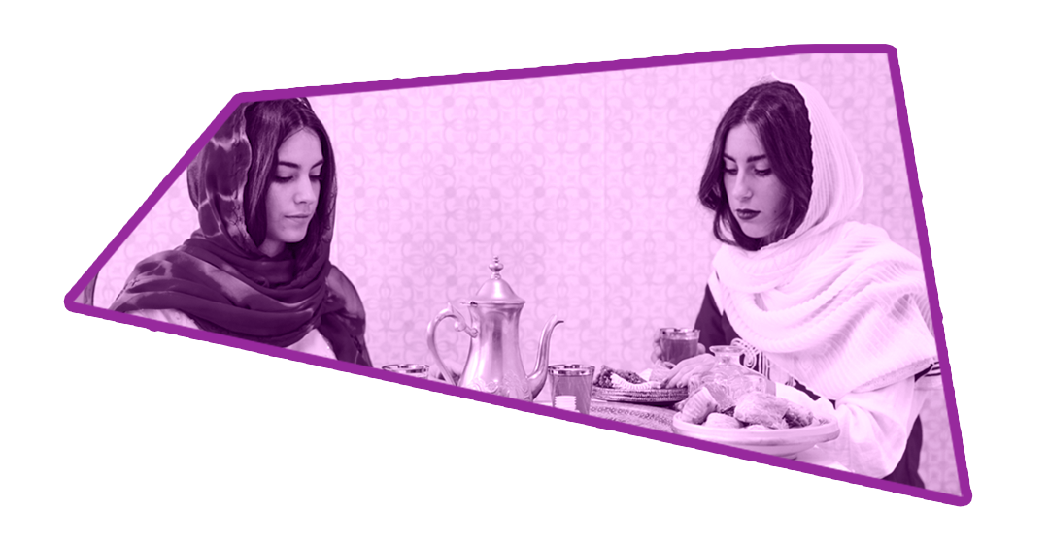
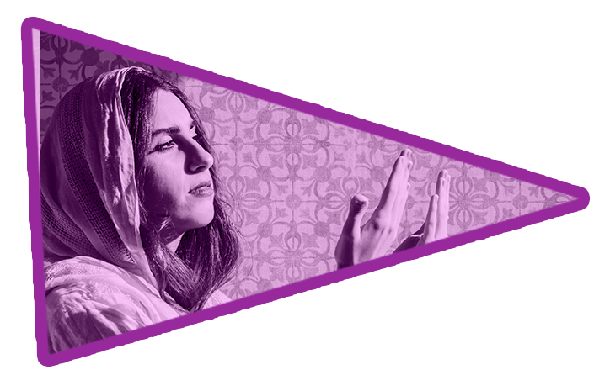
Social Issue:
Gender Stereotypes
By : Aaliyah Hinckson, Berna Kanay, Karen Zheng, Mildred Pena, Sadaf Chaudhry, and Valerie Kominer

Slide 2
What is a gender stereotype?
According to the United Nation, “a gender stereotype is a generalized view or preconception about attributes or characteristics, or the roles that are or ought to be possessed by, or performed by, women and men. A gender stereotype is harmful when it limits women’s and men’s capacity to develop their personal abilities, pursue their professional careers and/or make choices about their lives.”
Like most definitions, the definition for gender stereotype overly simplifies the extent of the harm that gender stereotypes cause.
Gender stereotypes have infiltrated the way that gender is viewed in society and has been doing so for generations.
This man-made phenomenon has caused a stagnation in progressivity worldwide.

Slide 3
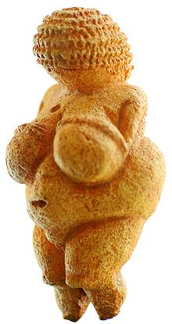
Historical Background of Stereotypes
In Ancient Times, the idea of gender did not have as heavy of a negative stigma. In fact, women were often put on a pedestal because they were deemed as essential for society, primarily because of fertility.
However, once different governmental systems came to be and the first great awakening introduced more stricter religious structures, the treatment of gender changed.
Hegemonic masculinity became an integral part of society, institutionalizing masculinity as a whole. Women were automatically deemed as inferior as a result.
Women were told to stay at home and cook, while the men became the breadwinners. In early monarchies, a queen’s role was to produce an heir, while a king ran the country.
With that in mind, it can only be assumed that men were also the ones who set these societal norms. Men gave other men the “okay” to act on a certain degree of masculinity, the way that the men acted towards women was then just an aftermath to those rules.
“Competition with other men provides a stage for establishing self both as an individual and as appropriately masculine. Competition also contributes to the perpetuation of male dominance” (Bird 127).
Men set the standard, and in order to achieve the highest level of so-called masculinity, men would compete to see who was the manliest. Women would endure toxic male dominance, that resulted from men wanting to achieve the highest level of masculinity. As explained by Bird, masculinity is not always directly related to sex. Nonsexual interpersonal communication and attractions play a very important role in the way that men perceive themselves. Ego-related competition becomes an avid part of the way that many men choose to live their manhood.
The Venus of Willendorf dates back to Paleolithic Period and its purpose was to show women as powerful.

Slide 4
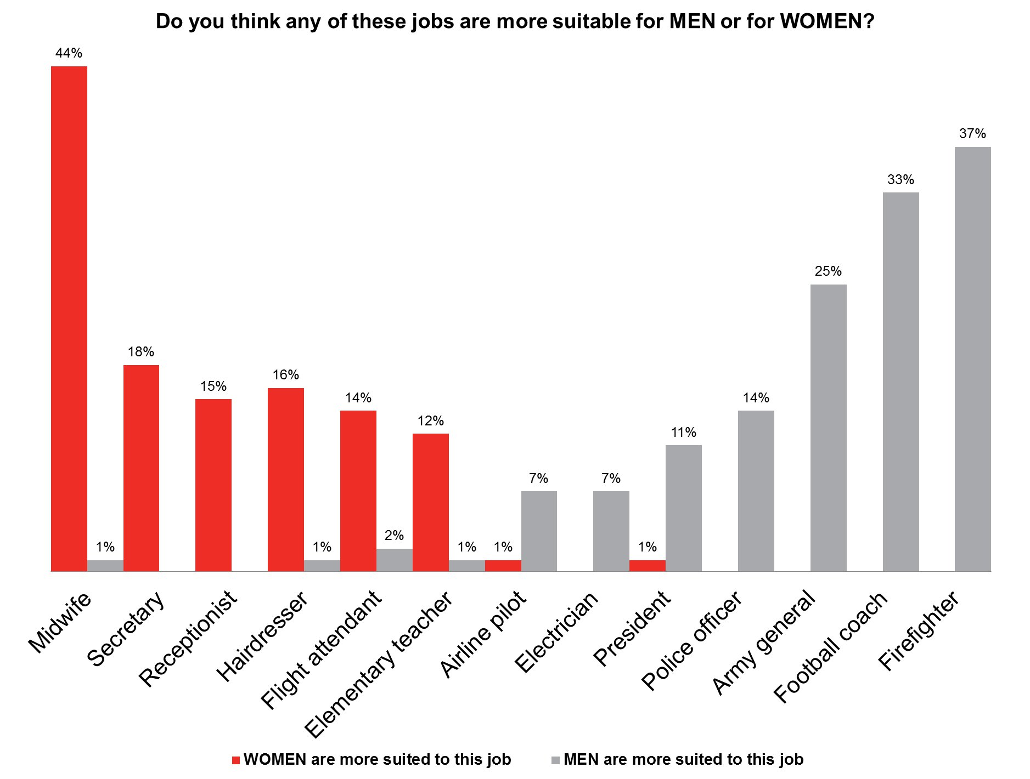
Historical Background of Stereotypes Continued…
Due to the interpretation of what was masculine and feminine, both genders fell victim to unfair scrutiny. Those who did not fall into the rigid template of masculine men and feminine women were seen as outsiders in society.
While the interpretation of gender has fluctuated throughout time, discrimiantion through the use of stereotypes has remained consistent.
As we will see in this presentation, in relation to careers, gender still plays a huge role in employment and status.

Slide 5
01
Childcare Workers

Slide 6
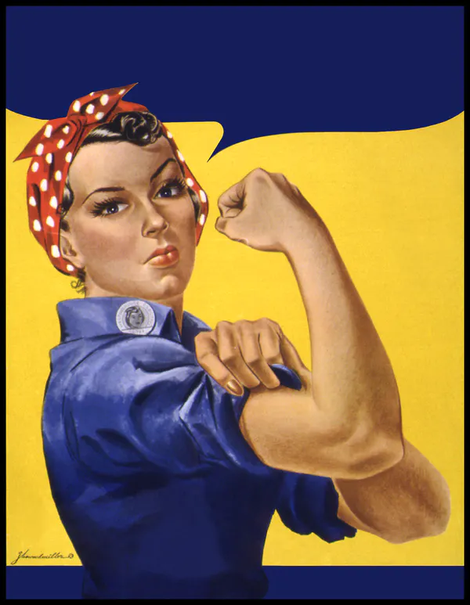
History of Childcare Systems
THE EARLY 1840S
WORLD WAR II
Two main periods in history contributing to the creation of daycare programs/systems:
The first childcare institutions in history were established.
Women were urged to work in factories during the Industrial Revolution of France.
Women joined the working force in an effort to fill the economic positions left empty by men who were enlisted for the upcoming war.
Increased demand for facilities that take care of and supervise children while their mothers worked.

Slide 7
Stereotypes in Childcare
Girls are often given dolls and dress-up apparel to play with that foster nurturing, social proximity, and role play.
One the other hand, motor skills and aggression are promoted in boys.
Responsibilities of a childcare worker include:
Planning and delivering age-appropriate activities
Playing with the children
Collaborating with other child care workers to develop programs that benefit children
Organizing and maintaining a classroom environment

Slide 8
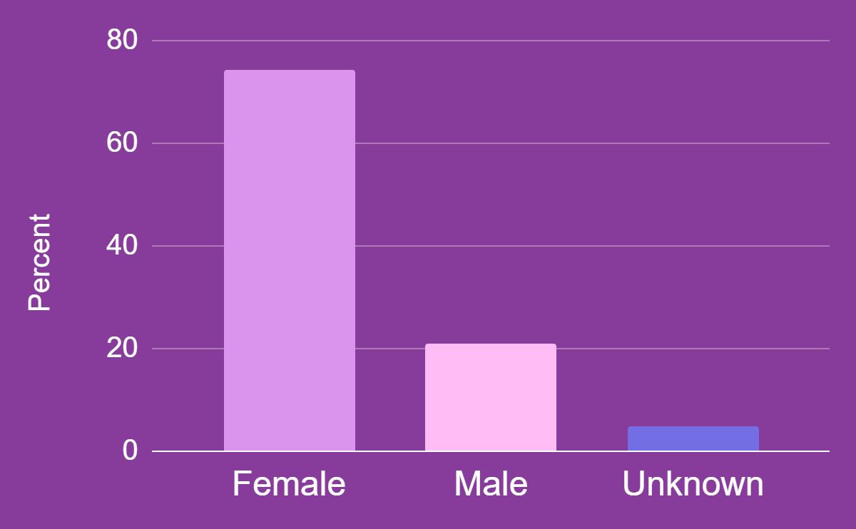
Statistics in Childcare
FEMALE
MALE
UNKNOWN
74.2%
20.9%
4.9%
Most jobs require a specific professional profile.
People who choose to enter the childcare field likely possess certain traits that fit with the requirements of their career profile.
All students who choose to become professional caregivers, female or male, are educated within the same curriculum during training.
Research shows that there are no differences between male and female caregivers in terms of attention, sensitivity, and stimulation.

Slide 9
02
Education

Slide 10
History In Education
While all the teachers you might have had until this day are all female, that was on always the case.
Prior to 1850, teaching was a career held in the majority by men. Boys received an education, while girls were taught how to perform household duties; this left a nearly impossible gap for women to jump if they wanted a career in education.
In the beginning, even basic education was reserved for the children of the rich, and college was a finishing school for the next generation of the aristocracy.

Slide 11
Why are Women Always Teachers?
Everyone always claim that teaching is a womens job but what about for men? According to a few sources the main reason why men do not become teachers was because other professions had a higher salary, but the second the teacher wages increase more and more males will join the field.
Some males even view teaching as a weaker job compared to business and mechanical jobs in the field.
Therefore, women almost always tend to be a teacher more likely than men.
Also, women are pushed to becoming teachers as it is the next best thing than being a housewife.
For instance, they work the same time their children have school and also have the same vacation as there children as well, which makes it the best job a women can ever ask for.

Slide 12
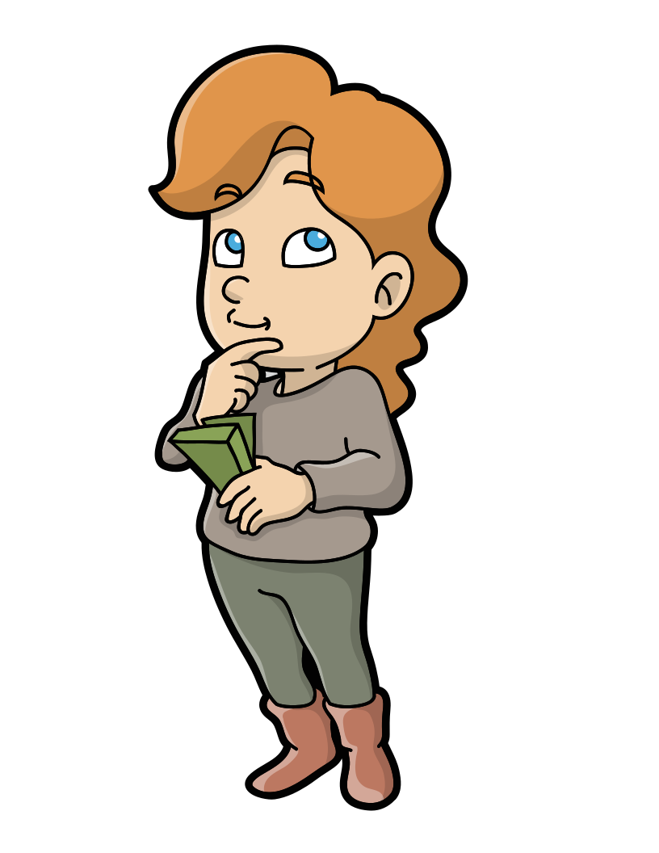
Stereotypes in Education
Women are always teachers, men are barely ever seen in a classroom unless they are the students.
Women teachers are best at teaching english rather than STEM classes.
Men do not teach at schools unless it is for P.E.
Teaching is the best profession for women because it is the next best thing to housewife.

Slide 13
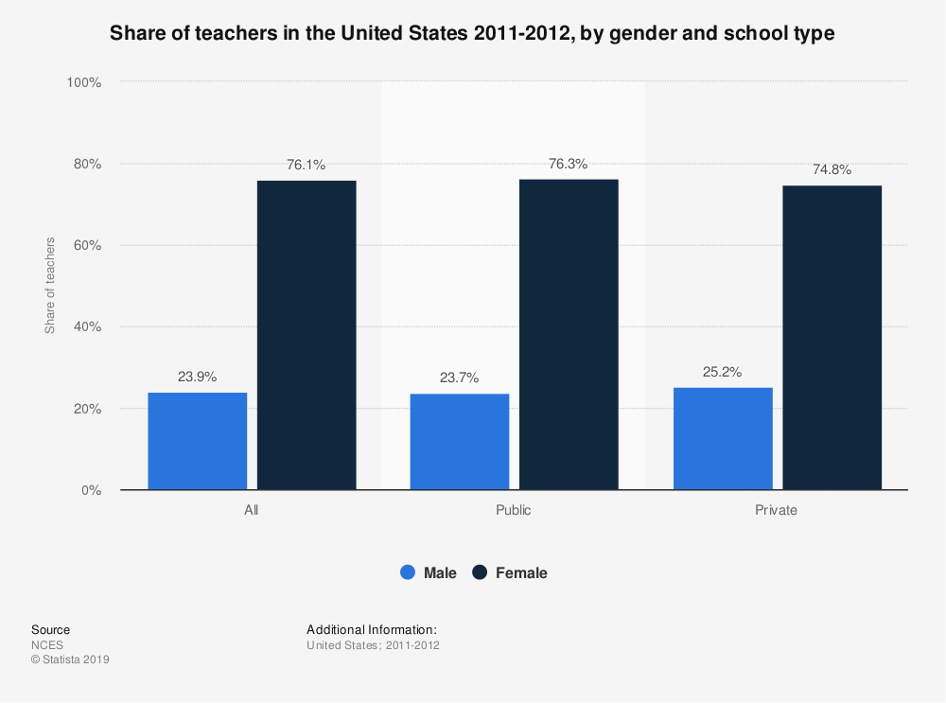
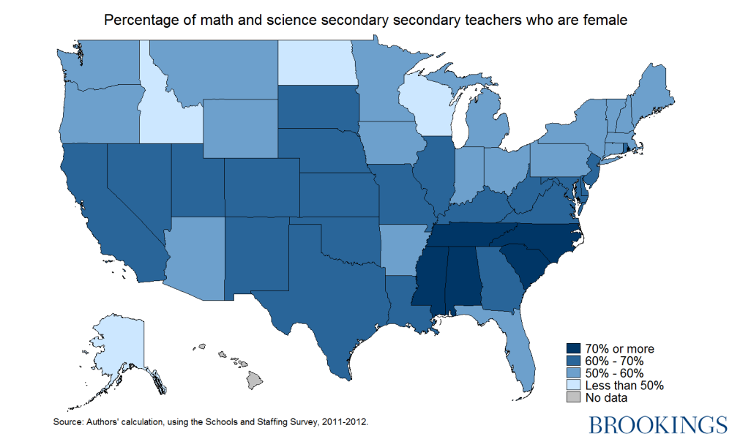
Statistics in Education

Slide 14
~Nelson Mandela~
“Education is the Most Powerful Weapon which you can use to change the world”

Slide 15
03
Politics

Slide 16
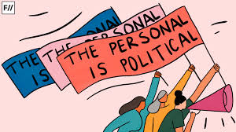
Gender Stereotypes in Politics
Gender composition of politicians has important implications over policymaking. Unfortunately, women are significantly underrepresented in political offices and one of the key reasons for this is the traditionally perceived characteristics that are associated with both men and women influence political selection process. Because politics is stereotyped into a category of musculine professions, women often receive major criticism and are expected to behave in a certain manner to prove their worth.

Slide 17
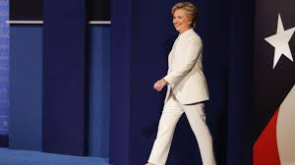
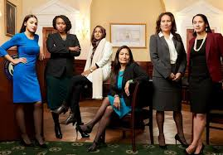
Politics Continued…
Fashion has been used to stereotype women in politics
For as long as women have been part of national politics, they have been held to standards of dress or appearance that certainly does not apply to their male counterparts.
In the early 20th century, when women first became involved in politics, they received major scrutiny for wearing colorful clothing, floral dresses, high heels, etc..
There are unwritten or explicit congressional rules regarding women’s dress code ethic
Media also plays a huge role in influencing this behavior towards women as they promote stereotypical narratives by making commentary on their dressing style and influences their popular support for office
Women are also deemed unfit for political office because they are too “emotional” and “impulsive”
People tend to view women through the traditional lens of gender roles and their political stance is often disregarded.
Fun Fact: The Pantsuit Nation group formed as a response to the criticism received by Hillary and has now become a voice for millions of marginalized individuals in the USA.

Slide 18
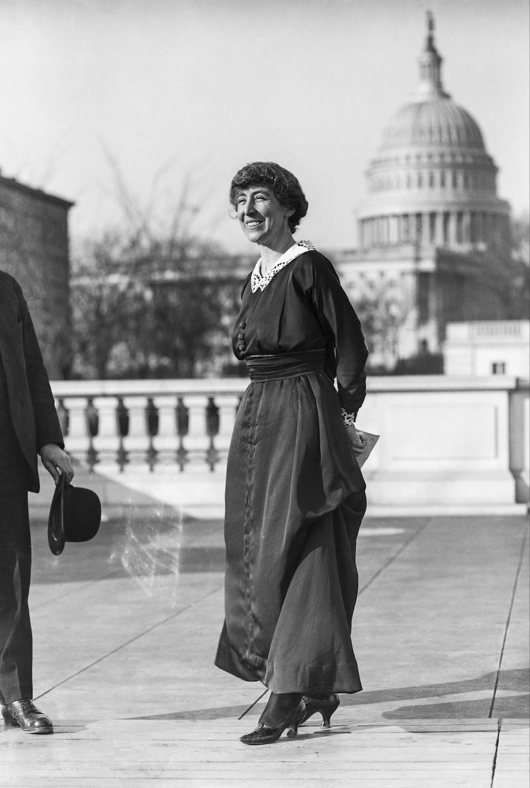
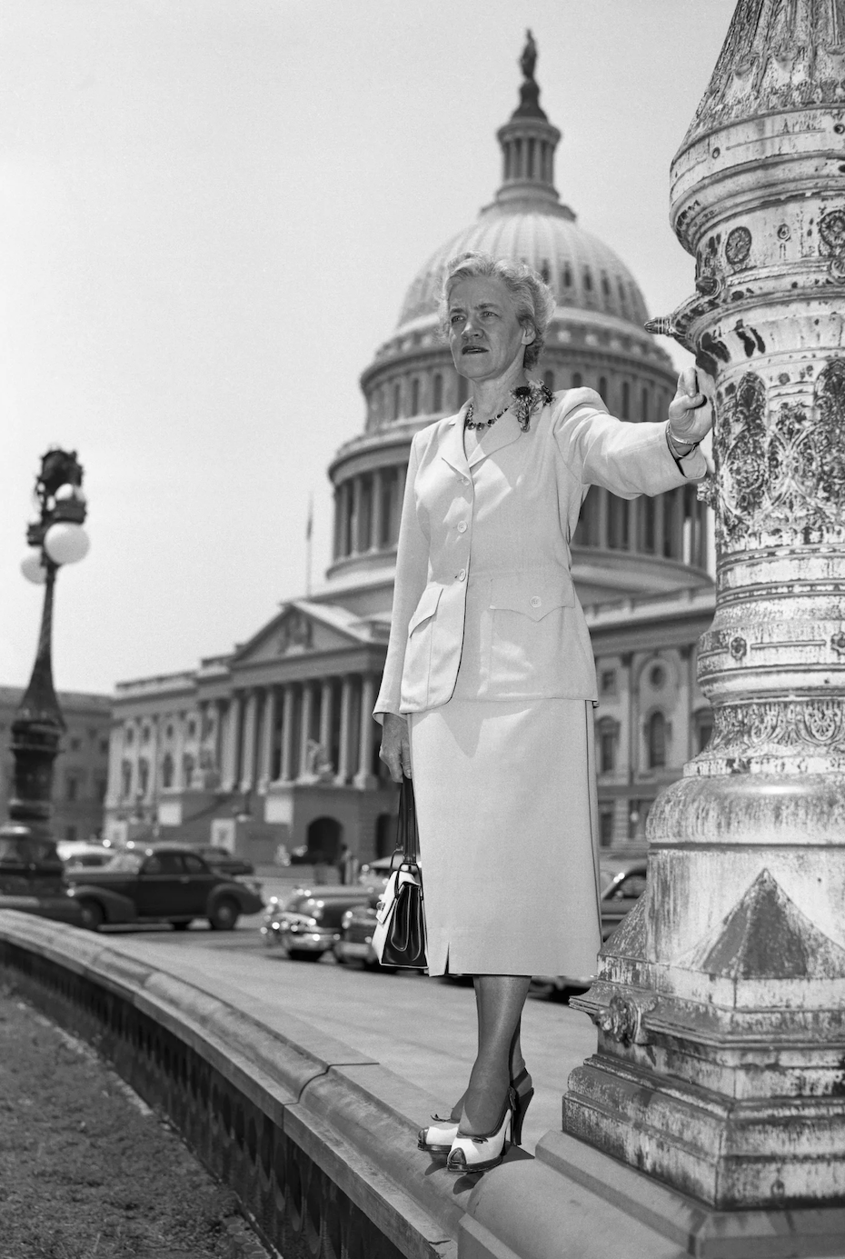
Congresswoman Jeannette Rankin
Sen. Margaret Chase Smith

Slide 19
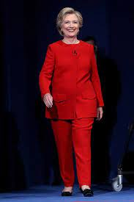
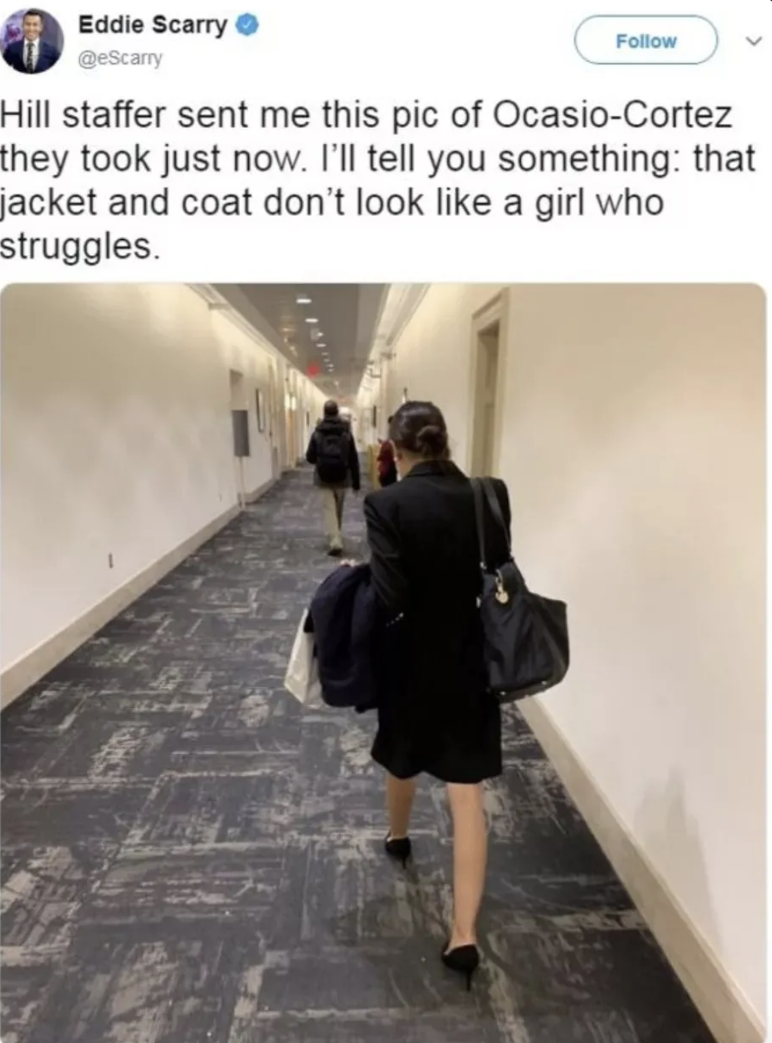
Former Secretary of State. Hillary Clinton
Congresswoman Alexandria Ocasio-Cortez

Slide 20
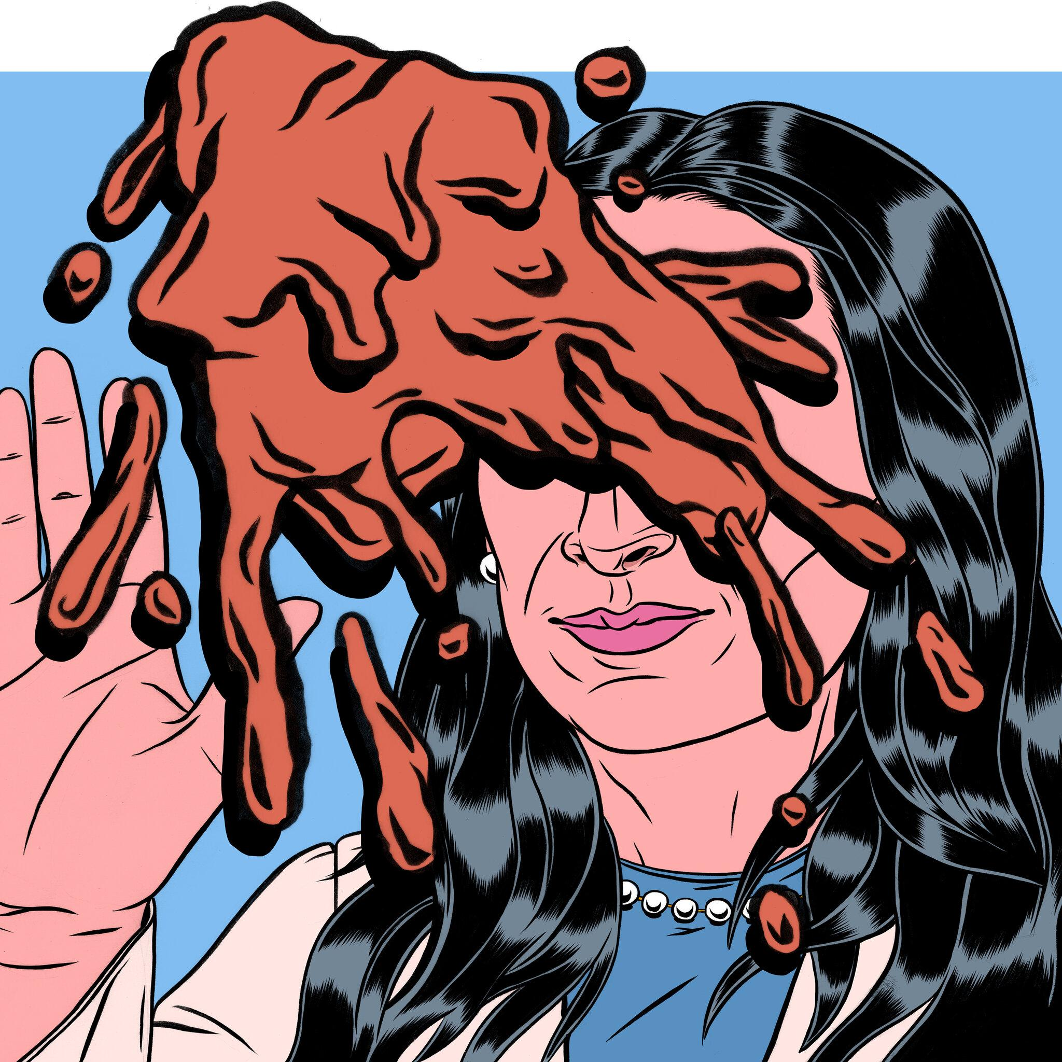
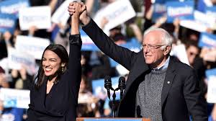
Politics Continued…
During any political campaigns, gender remains a key factor in influencing voter behavior. Voters rely on traditional norms to evaluate candidates.
“...voters are more likely to project feminine characteristics (such as compassion) onto women candidates while also expecting masculine traits (such as strength) to align with male candidates” (Irving, 2019).
Male or female; voters observe their political stance is viewed through the traditional lens of gender norms.
Female candidates are expected to present themselves to be more appealing to those feminine traits as well as masculine traits to prove their abilities. An attempt to maintain this balance makes obtaining support more challenging for female candidates compared to their male counterparts.
Irving in her research defines these masculine traits as being associated with certain political issues such as economic or military reform compared to feminine political issues which can be described as education, health care or child care.
Women in politics are highly scrutinized for how they present their masculine traits. “... they can’t behave too masculine without seeming unwomanly, while if they are too feminine, they don’t fit the expectations we have of leadership. To get elected, candidates need to play the gender game carefully” (Irving, 2019).

Slide 21
Politics Continued…
Male candidates are seen more fit for a presidential race because masculine political issues are evaluated as being more important than “feminine” tasks.
Media plays a significant role in promoting the stereotype that women are unfit to be politicians
The traditional stereotype of leadership being a masiuline trait influences media to see women politicians as less viable
“The association of women with private life, physical beauty, and nurturing, supporting roles can find its reflection in coverage focusing more on the personal background, physical appearance, marital status, and children (or lack thereof) of women politicians.”
campaigning strategies
Women candidates are judged harsher for negative advertisement as they are expected to be more “nicer” than the men because of the stereotypical image of women. Such negative advertisement is often a key strategy for winning office but it can be disadvantageous for women candidates.

Slide 22
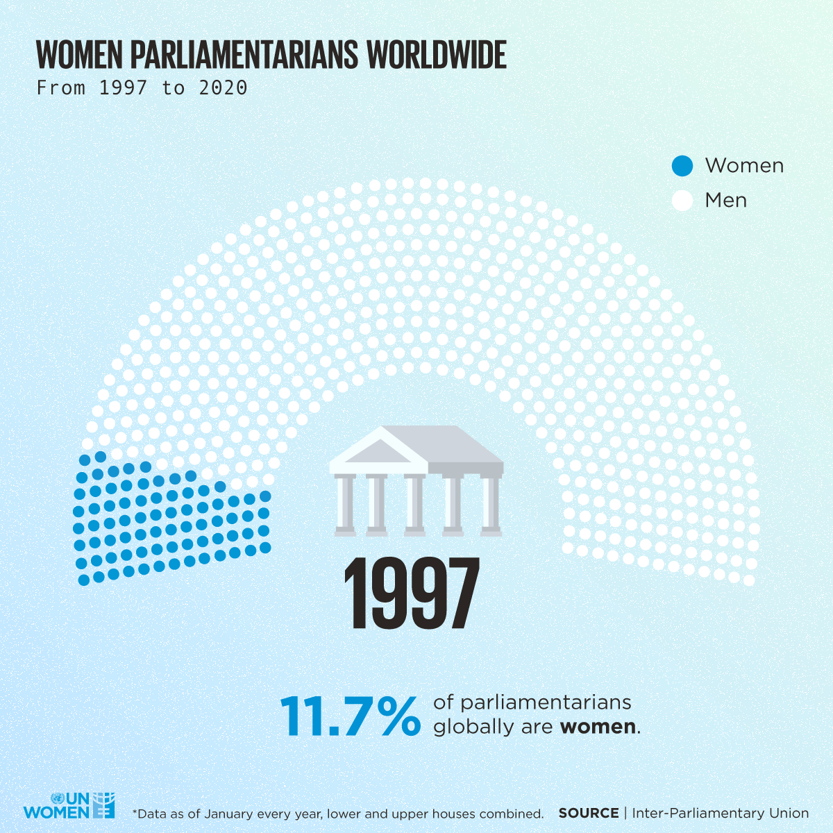
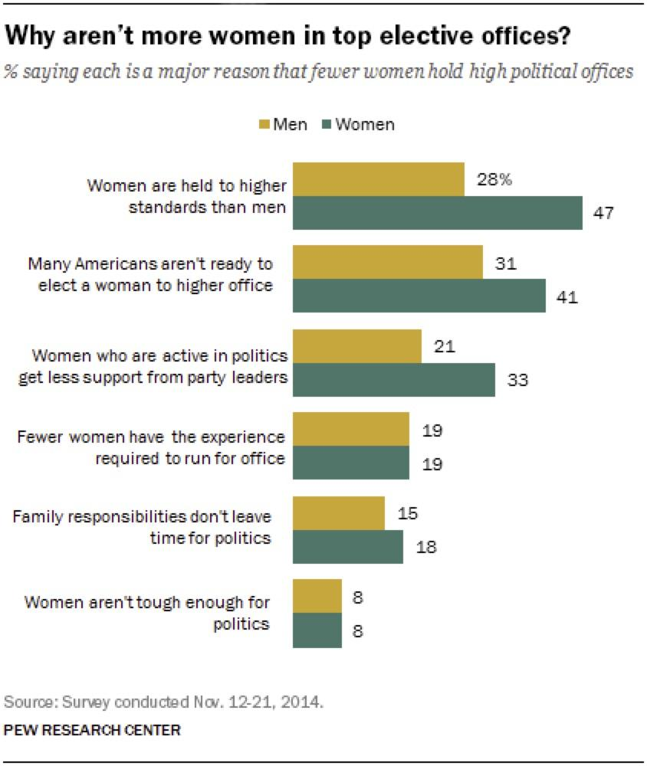
Politics Continued…

Slide 23
-Emma Watson
“Both men and women should feel free to be sensitive, both men and women should be free to be strong...it is time that we all view gender on a spectrum not as two opposing sets of ideals ”

Slide 24
04
Nursing

Slide 25
What was Nursing like before Stereotypes?
By the 1900s, nurses were given the stereotype of being feminine, middle class, Christian and white. This reflected Victorian ideas about femininity and imperialism. A source mentioned, “Female stars of stage and screen played nurses, while men are courageous soldiers and handsome doctors.” Men weren’t seen as nurses until later on.
One of the first male nurses in the United States is St. Cammilus de Lellis. The current red cross sign was authorized by Lellis himself

Slide 26
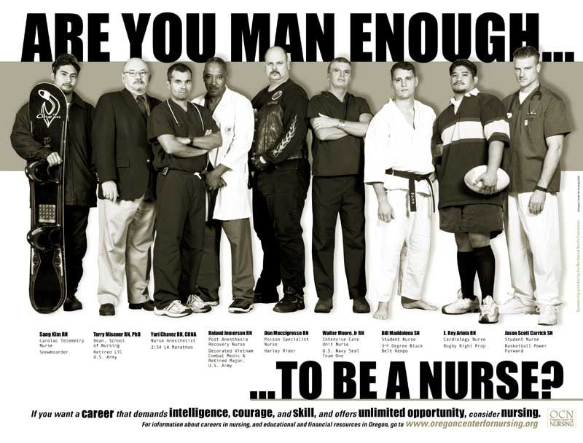
Male Nursing Stereotypes
Believe it or not, men are stereotyped more in this field than women
According to sources, many assume that nurses are supposed to be women because of their compassionate, caring and nursing spirit
Patients also assume that they are only in this profession to “see women naked”
Male nurses have a stigma placed on them because of the fact that most nurses are indeed women
Some stereotypes placed on male nurses are “Male nurses are a joke”, “Men become nurses because its easier”, “Male nurses are homosexual” and “Male nurses are failed doctors”
Male nurses have higher expectations than women; they must work harder to prove that they are just as capable as the women in the profession

Slide 27
How has the stereotype Evolved ?
According to the U.S. Bureau of Statistics, from 1970 to 2021, 12 % of registered nurses are male, which is 2.7% more than what it was in 1970
Enjoy this Tik Tok: https://www.tiktok.com/@ayyyobishop/video/6992954061326667014?lang=en&is_copy_url=0&is_from_webapp=v1&sender_device=pc&sender_web_id=703677105306724096

Slide 28
05
Firefighter

Slide 29
Women In Firefighting
Today, there are still some occupations that are considered “non traditional” for women.
Firefighting is seen as a masculine occupation or as some may call it, a “man’s job.”
All-women fire companies developed in King County, California and Woodbine, Texas, in the 1960’s.
In the United States, less than 5% of women have careers in firefighting.
When it comes to saving lives, gender should never be an issue.
Women are able to do the same jobs that men can do if they receive the proper training.

Slide 30
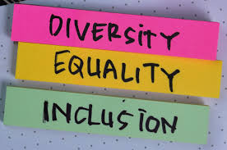
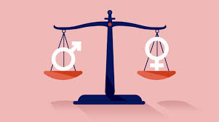
“How important it is for us to recognize and celebrate our heroes and she-roes!”
-Maya Angelou

Slide 31
Works Cited
Pacholok, Shelley. Into the Fire : Disaster and the Remaking of Gender, University of Toronto Press, 2013. ProQuest Ebook Central, https://ebookcentral.proquest.com/lib/brooklyn-ebooks/detail.action?docID=4669209
“History of Women in Firefighting.” Women in Fire, 23 Dec. 2016, https://www.womeninfire.org/firefighters/history-of-women-in-firefighting/.
Ainsworth, Susan, Alex Batty, and Rosaria Burchielli. “Women Constructing Masculinity in Voluntary Firefighting.” Gender, work, and organization 21.1 (2014): 37–56. Web.
Magazine, Smithsonian. “The Evolution of the Nurse Stereotype via Postcards: From Drunk to Saint to Sexpot to Modern Medical Professional.” Smithsonian.com, Smithsonian Institution, 24 Sept. 2014, https://www.smithsonianmag.com/history/evolution-nurse-stereotype-postcards-drunk-saint-sexpot-modern-medical-professional-180952725/#:~:text=By%20the%20early%201900s%2C%20nurses%20had%20a%20distinct,World%20War%20I%2C%20only%20added%20to%20this%20image
“Home.” TravelNursing, https://www.travelnursing.com/news/nurse-news/shattering-male-nurse-stereotypes/
“Child Care Worker - Demographics and Statistics in the US”. Zippia. https://www.zippia.com/child-care-worker-jobs/demographics/
Deborah SwansonDeborah Swanson is a Coordinator for the Real Caregivers Program at allheart.com. “Shattering Male Nursing Stereotypes.” Minority Nurse, 12 Nov. 2020, https://minoritynurse.com/shattering-male-nursing-stereotypes/

Slide 32
Works Cited Cont.
“The Male Nurse: Benefits and Percentages of Men in Nursing.” Southern New Hampshire University, https://www.snhu.edu/about-us/newsroom/health/male-nurse
.Mary. “6 Male Nurses in History You Should Know (but Probably Don't).” NurseBuff, 24 Aug. 2021, https://www.nursebuff.com/male-nurses-in-history/#:~:text=In%201955%2C%202nd%20Lt.%20Edward%20T.%20Lyon%20became,joining%20over%203%2C500%20commissi.
Bird, Barbara, and Candida Brush. “A Gendered Perspective on Organizational Creation.” Entrepreneurship Theory and Practice, vol. 26, no. 3, Apr. 2002, pp. 41–65, doi:10.1177/104225870202600303.
“Gender Stereotyping.” OHCHR, https://www.ohchr.org/en/issues/women/wrgs/pages/genderstereotypes.aspx.
Palmer, Kate. “Lasting Gender Stereotypes in the Workplace.” YouGov, YouGov, 9 Aug. 2012, https://today.yougov.com/topics/lifestyle/articles-reports/2012/08/09/lasting-gender-roles-workplace.
Venus of Willendorf, http://arthistoryresources.net/willendorf/.

Slide 33
Work Cited Cont.
Lisa, Andrew. “History of the American Education System.” Stacker, 10 Dec. 2020, https://stacker.com/stories/5541/history-american-education-system.
LeQuire, Shelby. “The History of Women as Teachers.” The Western Carolina Journalist, 4 May 2016, https://thewesterncarolinajournalist.com/2016/05/04/the-history-of-women-as-teachers/.
Statista Research Department, Research Group. “Share of Teachers in the U.S. 2012, by Gender and School Type.” Statista, 31 Aug. 2013, https://www.statista.com/statistics/238343/us-teachers-by-gender-and-school-type/.
Dews, Fred, and Tamari Dzotsenidze. “Charts of the Week: Gender and Education.” Brookings, Brookings, 15 Oct. 2019, https://www.brookings.edu/blog/brookings-now/2019/10/11/charts-of-the-week-gender-and-education/
Tani , Massimillano. “Why Are Teachers Mostly Female? Because Men Get Better Pay in Other Professions.” The Conversation, 21 Jan. 2019, https://theconversation.com/why-are-teachers-mostly-female-because-men-get-better-pay-in-other-professions-109569
“Visualizing the Data: Women's Representation in Society.” UN Women, https://www.unwomen.org/en/digital-library/multimedia/2020/2/infographic-visualizing-the-data-womens-representation.

Slide 34
Work Cited Cont…
Irving, Michelle. Women Politicians Must Still Bend to Gender Stereotypes. 3 Mar. 2019, https://policyoptions.irpp.org/magazines/march-2019/women-politicians-must-still-bend-to-gender-stereotypes/.
North, Anna. “America's Sexist Obsession with What Women Politicians Wear, Explained.” Vox, Vox, 3 Dec. 2018, https://www.vox.com/identities/2018/12/3/18107151/alexandria-ocasio-cortez-eddie-scarry-women-politics.
Cohn, D’Vera, and Gretchen Livingston. “Americans' Views of Women as Political Leaders Differ by Gender.” Pew Research Center, Pew Research Center, 7 Aug. 2020, https://www.pewresearch.org/fact-tank/2016/05/19/americans-views-of-women-as-political-leaders-differ-by-gender/.
Daphne Joanna Van der Pas, Loes Aaldering, Gender Differences in Political Media Coverage: A
Meta-Analysis, Journal of Communication, Volume 70, Issue 1, February 2020, Pages
114–143, https://doi.org/10.1093/joc/jqz046
Rosenwasser, Shirley Miller, and Norma G. Dean. “Gender Role and Political Office: Effects of
Perceived Masculinity/Femininity of Candidate and Political Office.” Psychology of
Women Quarterly, vol. 13, no. 1, Mar. 1989, pp. 77–85,
doi:10.1111/j.1471-6402.1989.tb00986.x.
https://www.everycrsreport.com/reports/RS20615.html
https://www.youngacademics.com.au/blog/the-story-behind-it-all/

Slide 35
Thank you for listening! Now any question? :)

